Slide 1


P08: AGRIQUAL
HIGH LEVEL ARCHITECTURE

Slide 2
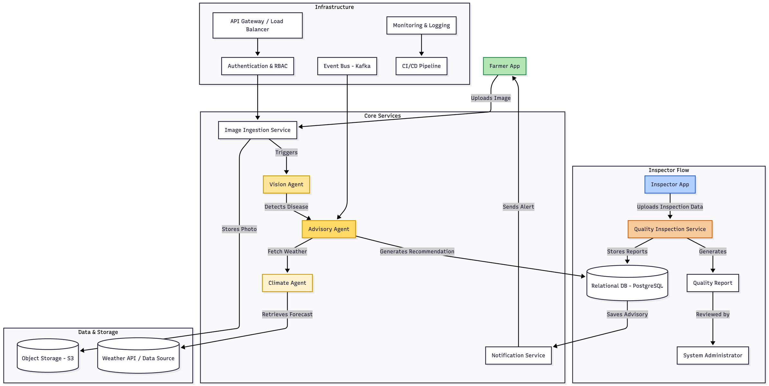
ARCHITECTURE DIAGRAM
Infrastructure Layer: Manages system backbone—API Gateway, authentication, logging, event bus, and CI/CD for scalability and security.
Inspector Flow Layer: Manages inspection workflows—uploads data, grades samples, and generates quality reports
Core Services Layer: Handles main logic—image ingestion, AI-based vision, climate, and advisory generation services.
Data & Storage Layer: Stores structured and unstructured data—images, reports, weather data, and advisories in databases and S3.

Slide 3
NON-FUNCTIONAL REQUIREMENTS
1. The system should process and classify an uploaded image in less than 15sec
Vision Agent runs on GPU-optimized instances with PyTorch models pre-loaded in memory, eliminating initialization delays
Images upload directly to Object Storage via pre-signed URLs, bypassing API bottlenecks for faster processing
Redis caches recent predictions for common crops and diseases, enabling instant responses for repeated queries
SLA Guardrail monitors inference latency and triggers Kubernetes autoscaling when processing time approaches threshold
2. The system should support at least 100 concurrent users
API Gateway with Load Balancer distributes incoming requests across multiple stateless Kubernetes pods to handle high concurrent traffic
Redis stores session data externally in a centralized cache, enabling any service instance to handle any user request without binding users to specific servers
CDN caches static frontend assets at edge locations closer to users, offloading backend traffic and improving response times
3. The system should provide clear error logs for troubleshooting
All microservices emit structured JSON logs with standardized fields (timestamp, trace_id, error codes) for consistent troubleshooting
Each request receives a unique tracking ID that follows it through all system components, making it easy to trace errors across services

Slide 4
SECURITY REQUIREMENTS
1.Broken Access Control
Broken access control typically leads to unauthorized information disclosure, modification, or destruction of all data or performing a business function outside the user's limits.
Secure Login & Role Access – Users authenticate via the web app; Auth Service verifies credentials and issues short-lived JWT tokens based on roles.
Controlled API Access – All requests go through the API Gateway with WAF and rate limiting; only authorized microservices inside the private VPC are accessible.
Data Protection & Audit – Services revalidate ownership, encrypt traffic (HTTPS + mTLS), and log all actions for traceability and compliance.
2.Injection Attacks (SQL injection, file/command injection)
Untrusted input can alter queries or invoke unintended commands, leading to data compromise or remote execution.
Request & Input Validation – API Gateway enforces OpenAPI/JSON-Schema validation; all inputs sanitized before reaching microservices.
Safe Data & File Handling – Services use ORM and least-privilege DB access; uploads scanned, validated, and stored securely via pre-signed URLs.
Secure Execution & Communication – Tasks run in sandboxed containers; no direct shell access; errors sanitized; all traffic encrypted end-to-end (HTTPS + mTLS).
3.Data Poisoning (tainted inputs into diagnosis/training)
Malicious or low-quality data can corrupt model training or skew diagnosis, harming recommendations and trust.
Secure & Verified Data Pipeline – All uploads go through the Ingestion Service for format, quality, and anomaly checks; suspicious files are quarantined before storage.
Controlled Model Lifecycle – Models come only from the signed, versioned Model Registry; training uses approved datasets with provenance and integrity validation.
Safe Deployment & Monitoring – New models are canary-deployed, monitored for drift and KPIs; auto-rollback ensures stability; every action is logged and auditable.

